Slide 1
Star Wars: Legacies of Science Fiction and Space Opera
Ben Ostermeier

Slide 2
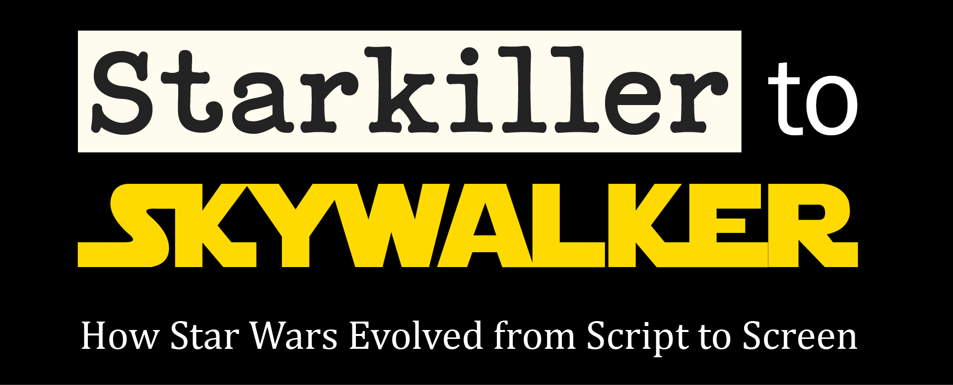
See also
exhibits.library.illinois.edu/s/rbml/page/star-wars

Slide 3
War of the Worlds Manuscript by H.G. Wells
Handwritten manuscript from 1895 to 1897
Highly influential science fiction novel
Commentary on British imperialism
Plot: Earth is invaded by Martians
Created strong link between science fiction and warfare
Wells Collection C14.08.06

Slide 4
A Fighting Man of Mars by Edgar Rice Burroughs
First edition, 1931
George Lucas copied extensively from this book when drafting his first attempt at a Star Wars story in 1973
Part of Barsoom series set on Mars, featuring John Carter
S. B945f

Slide 5
Second Foundation by Isaac Asimov
First edition, 1953
Third book in Foundation series
Series is about the collapse of the Galactic Empire and a plan to restore it
Strong similarities between the Empire in Foundation and the Republic and eventual Empire in Star Wars
Both Star Wars and Foundation political settings are based on the Roman Republic and Empire
JAFFE 813 AS4S 1953

Slide 6
2001: A Space Odyssey by Arthur C. Clarke
First edition, 1968
Developed alongside movie directed by Stanley Kubrick
The film was highly influential on George Lucas
In the fictional story, HAL 9000 was created at the University of Illinois
One of the first commercial successful science fiction films (but it took until 1975)
JAFFE 823 C552TW 1968

Slide 7
Children of Dune by Frank Herbert
First edition, 1976
Third book in Dune series
Aesthetics, themes, and plot elements of Dune highly influential on Star Wars
Dune has a desert planet, a secretive religious order with magic powers, and a protagonist with humble origins
JAFFE 813 H413C

Slide 8
The Deadly Queen Mesala Flash Gordon Comic
1988, from India
Original comics and movie serials from 1930s
George Lucas originally tried to get movie rights to Flash Gordon
After he couldn’t, made Star Wars instead
Two copies, one in English and one in Hindi
IUB01627

Slide 9
The Adventures of Luke Starkiller as taken from the ‘Journal of the Whills’. Saga I: Star Wars
Part of the RBML TV and movie script collection
Title page and first 54 pages are dated March 15, 1976
p. 55 and onwards dated April 19, 1976
Note on intro page, “Transfer closed stacks to Rare Book Rm. June 1982”
Written by George Lucas with edits by Willard Huyck and Gloria Katz
Q. Scripts 791.4372 St962ℓ1976

Slide 10
Star Wars Script continued
Shooting script for Star Wars
Updates made during production
The name Starkiller appears in first 54 pages, later pages name him Skywalker
Includes several deleted scenes, including early scenes with Luke
Other dialogue changes were made either by Lucas or actors ad-libbing
Q. Scripts 791.4372 St962ℓ1976

Slide 11
Splinter of the Mind’s Eye by Alan Dean Foster
First edition, 1978
First Star Wars expanded universe book
Plot: Luke and Leia seek Kaiburr crystal and encounter Darth Vader
Foster also wrote novelization of original film
Foster wrote Splinter during production of original film to be a cheap sequel
Jaffe 813 F8112s

Slide 12
Star Wars: Return of the Jedi Press Kit
1983
Includes various press releases and black and white still photos from the film
Also has press release titled “Introducing the Ewoks”
From Leskosky collection of film press kits
Promotional materials to share with the media to promote the film
MSS00030 Item 1894

Slide 13
The Mos Eisley Cantina Pop-Up Book by Kevin J. Anderson and Rebecca Moesta
1995 book
Features backstories for many of the patrons of the Mos Eisley Cantina seen in the movie
Last page has pop up and working music box that plays the cantina band theme
Q. S. An234s

Slide 14
Star Wars Special Edition Press Kit
1997
From Leskosky collection of film press kits
Promotional materials to share with the media to promote the Star Wars re-release
Includes various press releases and black and white still photos from the original trilogy
Press release makes limited mention of story changes
MSS00030 Item 1895

Slide 15
Star Wars: A Pop-Up Guide to the Galaxy by Matthew Reinhart
2007 pop-up book
Created for Star Wars 30th anniversary
Focuses solely on original trilogy
President Barack Obama bought this book for the son of White House press secretary Robert Gibbs in 2010
S. R275s

Slide 16
William Shakespeare's Star Wars: Verily, A New Hope by Ian Doescher
2013 book
Story of original Star Wars written in the style of a Shakespeare play
Written in iambic pentameter
Entire Star Wars Skywalker Saga has been written in Shakespeare style
IUB02021

