Slide 1
Making searchable pdfs using ocr
SAVVY RESEARCHER fALL 2020

Slide 2
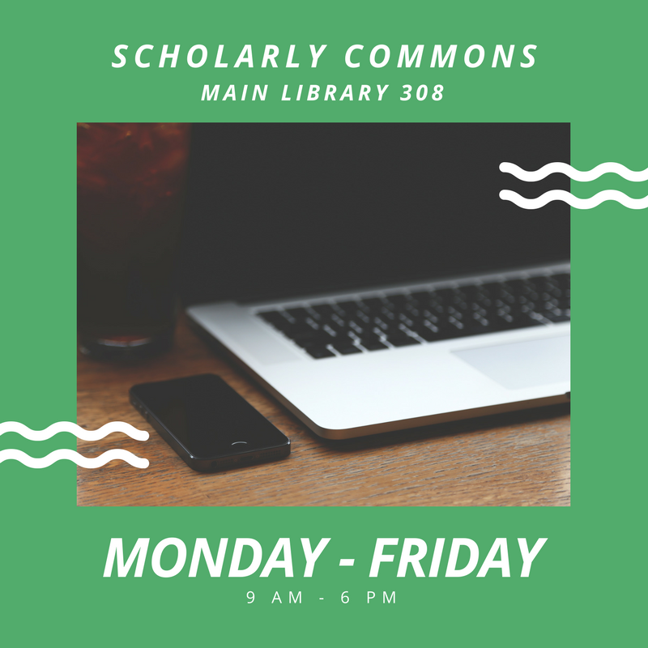
Scholarly Commons
Main Library 306
Virtual Hours
10:00 am – 2:00 pm
Monday-Friday
sc@library.Illinois.edu
Live Chat! via “Ask a Librarian” on SC Homepage

Slide 3
Introductions
Please say:
  Your name
  Major/year
  What brought you to this workshop today?

Slide 4
What is ocr?

Slide 5
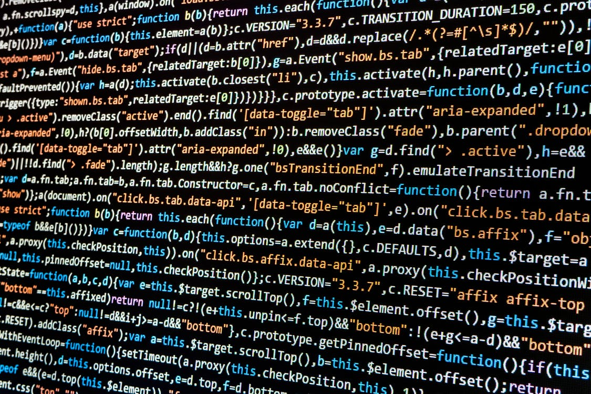
Optical character recognition!
Electronic identification & digital encoding of printed characters
Requires optical scanner and/or specialized software

Slide 6
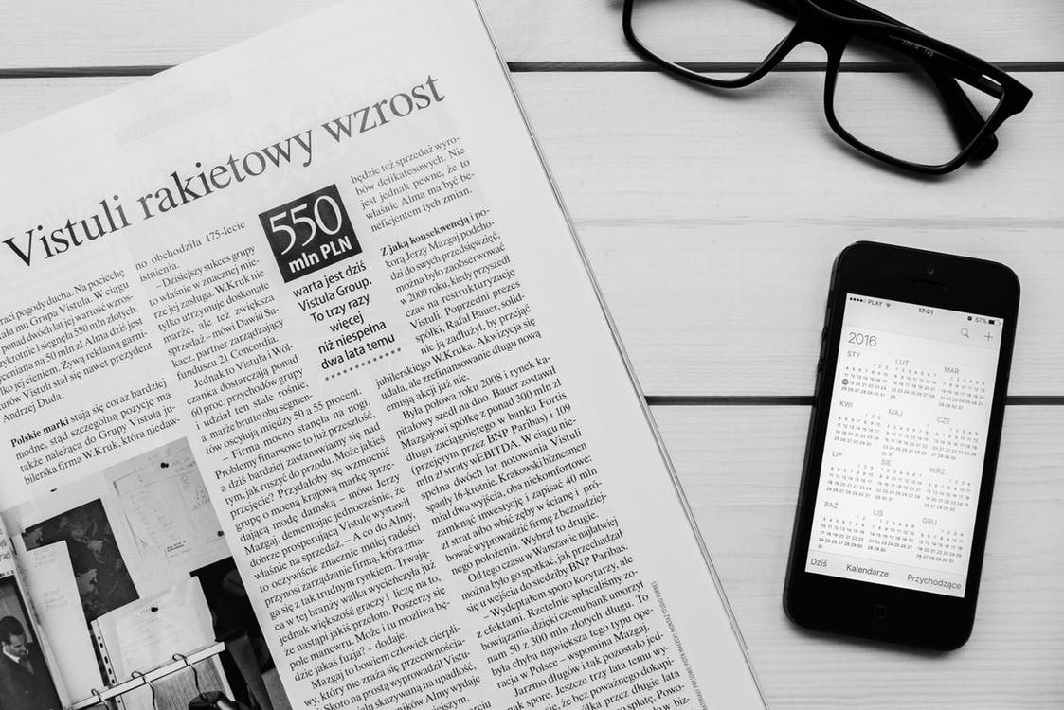
Various uses of Ocr
Large-scale digitization projects
  Newspaper digitization projects – UIUC Library Newspaper Database
Text comparison/analysis
  The Wide, Wide World Digital Edition Project
  widewideworlddigtialedition.siue.edu
Accessibility & searchability of texts
  Use of screen readers/text-to-speech
  ALTO (Analyzed Layout Text Object)

Slide 7

Today’s outcomes
You will be able to identify the function and benefit of OCR software
You will be able to pick the OCR software best suited to your needs

Slide 8
Considerations before you start your ocr
Scanning
The recommended resolution for best scanning results for OCR accuracy is 300 dots per inch (dpi).
Brightness settings that are too high or too low can have negative effects on the accuracy of your image. A brightness of 50% is recommended.
The straightness of the initial scan can affect OCR quality. Skewed pages can lead to inaccurate recognition.
Older and discolored documents must be scanned in RGB mode in order to capture all of the image data.
Text
Language: texts published before 1850 may not be the most compatible with OCR software. However, if the pages you are scanning are in different a different language, many OCR systems allow you to select the language of the document.
Documents with low contrast can result in poor OCR.
  Typescript results in poorer OCR than printed type; This includes handwritten texts, small fonts, or abstract fonts.
  Inconsistent use of font faces and sizes can lower OCR accuracy.

Slide 9
Four questions when choosing a software
What do I want my output to be?
What type of file do I need and how will it be used?
Is precision and accuracy a priority?
Are there standards for your project/repository?

Slide 10
OCR Software

Slide 11
OCR: A Comparison
Tesseract
Adobe acrobat
Cost: Free
Requirements: Able to run on Mac or PC
Notable Features: Open source, run through command line interface, only uses image files
Cost: $ (Free this academic year for UIUC affiliates)
Requirements: Able to run on Mac or PC
Notable Features: Can read multiple documents at the same time, automatically deskews images
Readiris
ABBYY FIneReader
Cost: $$
Requirements: Able to run on Mac or PC
Notable Features: Cloud Storage; Evernote, Dropbox, Box & Google Drive; recognizes over 130 languages
Cost: $$$ (Available through the Scholarly Commons)
Requirements: Able to run on Mac or PC
Notable Features: Can recognize 190 languages, built-in text editor, can train the program for batch edits
Notes:
Tesseract: free! Not too difficult to get up and running, but can be difficult for those unfamiliar with CLIs
Acrobat: on slide, mostly ubiquitous
Readiris: not going in-depth on this one, no spell checker; fewer editing options
ABBYY: Most robust, built-in text editor for verifying text in the interface itself

Slide 12
ABBYY FineReader

Slide 13

Getting Started with ABBYY
Good for…
  Precision editing options
  Working with unique text
  Linking to text analysis software
  Converting between formats
Considered more “academic”
Needs more active learning time for fluency
Notes:
Best for large projects that need accurate OCR
editing: Verify Text to go through all the errors and correct them as you go.
190 languages and full dictionary support for 48
ATLAS.ti or Nvivo

Slide 14
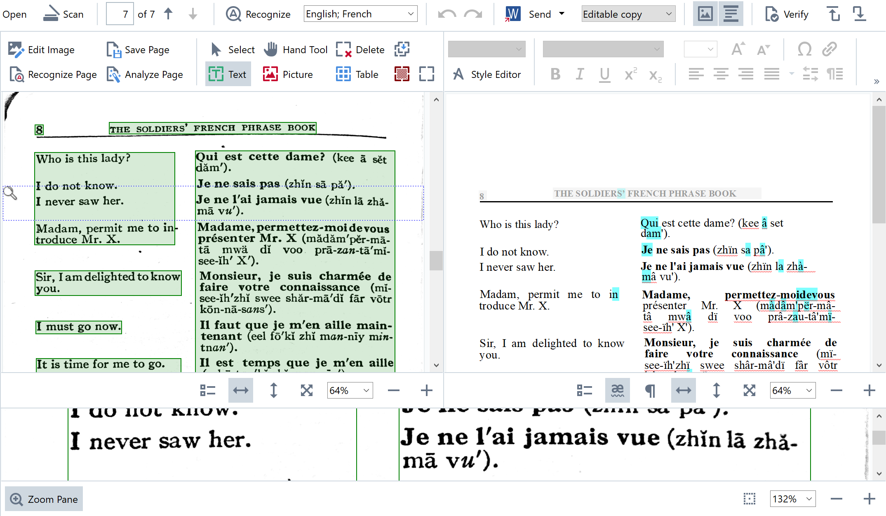
ABBY allows you to compare the original scanned image (left) with the OCR result (right)

Slide 15
When would you use ABBYY?
If you need to make precise adjustments to the OCR result.
If you’re working with unusual images that require more sophisticated OCR, such as scans of older text, unusual typography, or non-Latin script.
Notes:
Can train OCR to recognize certain characters

Slide 16
Tesseract

Slide 17
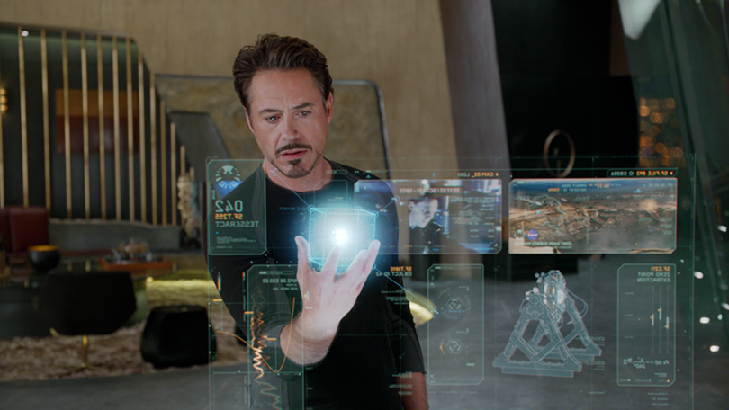
Tesseract: Fast Facts
Open source, free software
  https://github.com/tesseract-ocr/tesseract/wiki
No built-in user interface
Control through the command line
Only works with image files
Other developers have made interfaces for Tesseract that are like ABBYY
  https://tesseract-ocr.github.io/tessdoc/User-Projects-–-3rdParty.html

Slide 18
When would you use tesseract?
If you have programming expertise and want more direct control over the OCR process itself.
If you want more precise OCR correction but don’t have access to ABBYY FineReader.
  - Could use one of the free interfaces made with Tesseract.

Slide 19
Adobe Acrobat Pro

Slide 20

Intro to Adobe Acrobat Pro
PDF creator
Good for…
  Converting documents from one format to another
  Combining multiple files into one PDF
  Editing PDFs
Simple and popular
  Likely to see outside of an academic setting

Slide 21
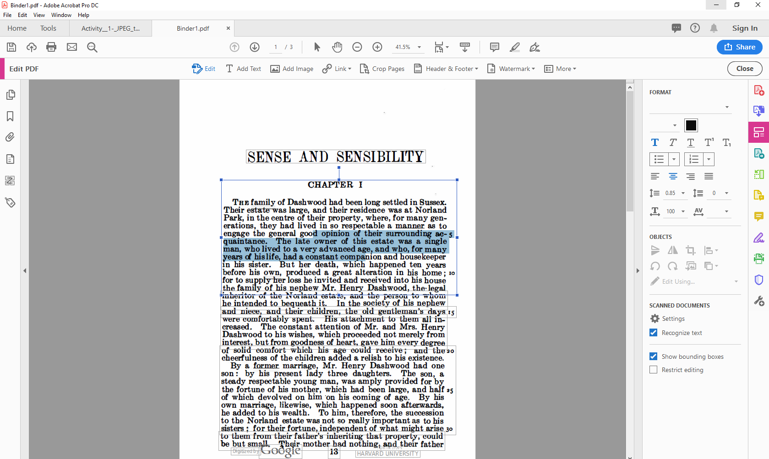
Adobe Acrobat performs OCR for you and then allows you to select and edit text within the document

Slide 22
The downside
There isn’t an easy way to compare the original image of text with the OCR text result

Slide 23
When would you use Acrobat?
If you want a quick and easy OCR result where you don’t need to make significant corrections
If you’re working with an image of text that OCR performs well with, such as high-quality scans of 20th or 21st century Latin alphabet text.
Notes:
For example, if you have an image of text where you just want to highlight certain sections of text or want to do a quick text search.

Slide 24
Any questions?

Slide 25
Which Software would you use?

Slide 26
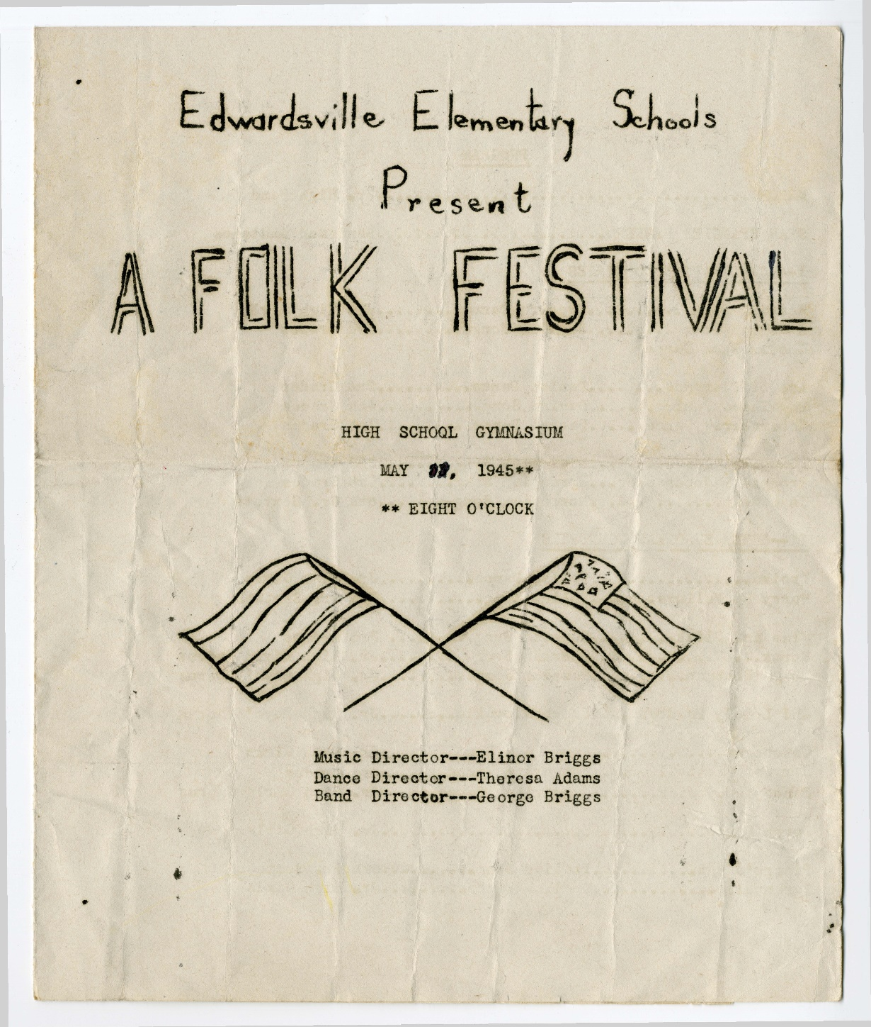
“1945 Program for "Edwardsville Elementary Schools Present A Folk Festival",” Madison Historical, accessed October 30, 2020, https://madison-historical.siue.edu/archive/items/show/1618.

Slide 27
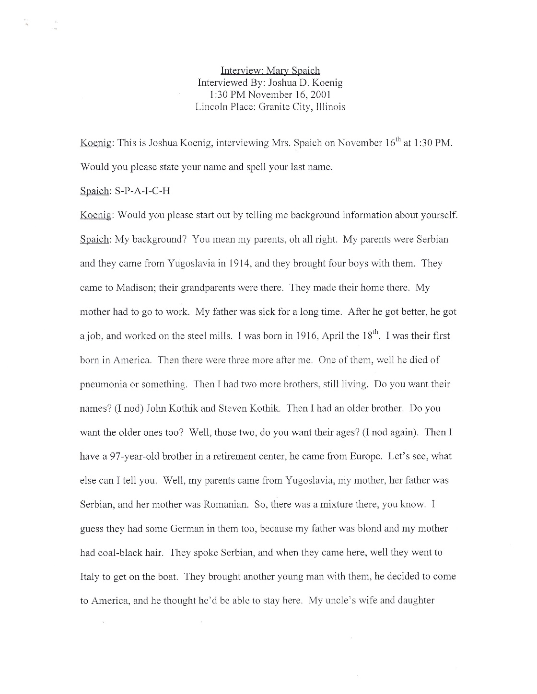
“Mary Spaich Oral History Interview,” Madison Historical, accessed October 30, 2020, https://madison-historical.siue.edu/archive/items/show/2252.

Slide 28
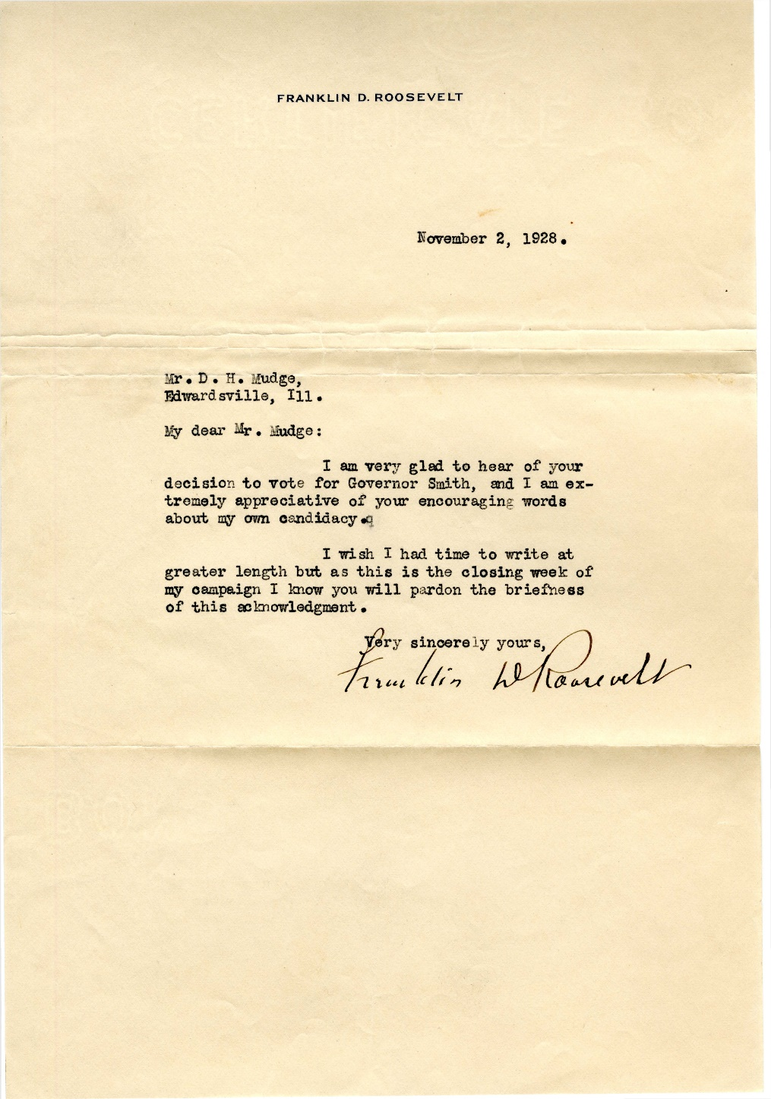
Roosevelt, Franklin Delano, “Letter from Franklin D. Roosevelt to D. H. Mudge Sr.,” Madison Historical, accessed October 30, 2020, https://madison-historical.siue.edu/archive/items/show/819.

Slide 29
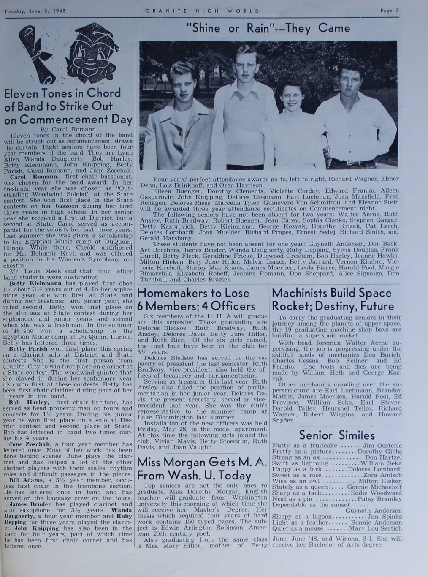
“"Granite High World" School Newspapers for the 1947-48 School Year,” Madison Historical, accessed October 30, 2020, https://madison-historical.siue.edu/archive/items/show/595.

Slide 30
Let’s put it to practice
demonstration!

